Slide 1
Introduction to VHDL
M. Balakrishnan
Dept of Computer Science & Engg.
I.I.T. Delhi

Slide 2
Domains of Description :
Gajski’s Y-Chart
Structural
domain
Behavioral
domain
VHDL models
Level of
abstraction
Physical domain

Slide 3
VHDL Development
US DoD initiated in 80’s
Very High Speed ASIC Description Language
Initial objective was modeling only and thus only a simulator was envisaged
Subsequently tools for VHDL synthesis were developed

Slide 4
HDL Requirements
Abstraction
Modularity
Concurrency
Hierarchy

Slide 5
Abstraction
VHDL supports description of components as well as systems at various levels of abstraction
Gate and component delays
Clock cycles
Abstract behavior without any notion of delays

Slide 6
Modularity
Every component in VHDL is referred to as an entity and has a clear interface
The interface is called an entity declaration
The “internals” of the component are referred to as the architecture declaration
There can be multiple architectures at even different levels of abstraction associated with the same entity

Slide 7
VHDL Example
a
AND
c
b

Slide 8
VHDL Description: AND gate
entity AND2 is
port (a, b: in bit ;
c : out bit);
end AND2;
architecture beh of AND2 is
begin
c <= a and b;
end beh;

Slide 9
Concurrency in VHDL Descriptions
signals
signals
process 1
process 2
process n

Slide 10
Concurrent and Sequential Computations
Processes are concurrent
Sequential activity within each process
Nesting of statements :
Concurrent statements in a concurrent statement
Sequential statements in a concurrent statement
Sequential statements in a sequential statement

Slide 11
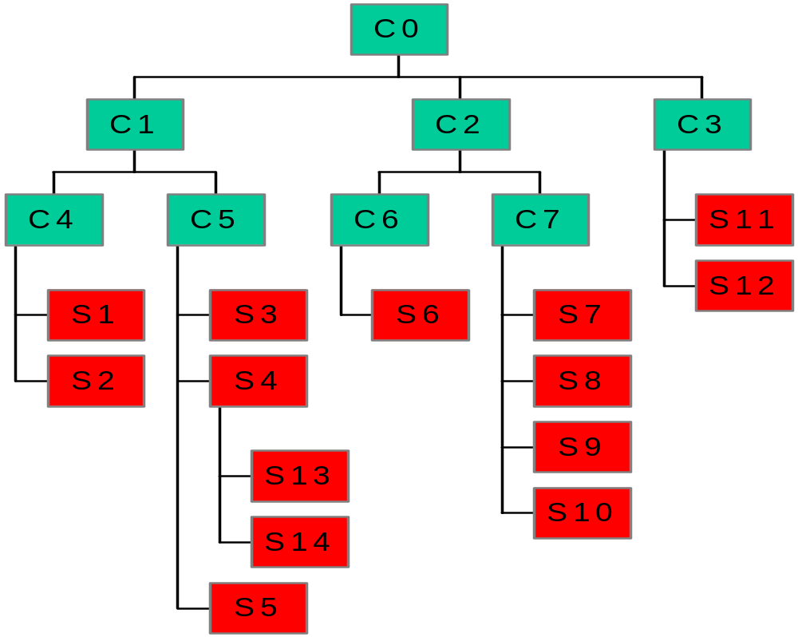
Hierarchy in VHDL

Slide 12
Modeling Styles in VHDL
M. Balakrishnan
Dept. of Comp. Sci. & Engg.
I.I.T. Delhi

Slide 13
Modeling Styles
Semantic model of VHDL
Structural description
Data Flow description
Algorithmic description
RTL description

Slide 14
Modeling Choices in VHDL
Behavioral and Structural Domains
  Several Levels of Abstraction
Multiple Styles of Behavioral Description:
  Data Flow Style (concurrent)
  Procedural Style (sequential)
Combinations, variations and special cases of these, e.g.,
  special case of data flow style - FSM described using guarded blocks
  special case of procedural style - FSM described using case statement in a process

Slide 15
Structural Description
Carries same information as a NET LIST
Net List = (Component instances) + (Nets)
Structural Description in VHDL =
  (Signals) + (Component instances + Port maps)
Many sophisticated features in VHDL to make it more versatile:
  * Variety of signal types
  * Generic components
  * Generate statements for creating arrays of component instances
  * Flexibility in binding components to design entities and architectures

Slide 16
Behavioral Description
Procedural
  (textual order => execution order)
Sequential statements
Control constructs alter normal sequential flow
Called Behavioral description in VHDL
Non-procedural
  (textual order NOT => execution order)
Concurrent statements
Data flow (or rather data dependency restricts concurrency)
Called Data flow description in VHDL

Slide 17
Concurrent Statements in VHDL
process statement -- behavior
concurrent procedure call -- behavior
concurrent signal assign. -- data flow
component instantiation -- structure
generate statement -- structure
block statement -- nesting
concurrent assertion stmt -- error check

Slide 18
Example: 1-bit Full Adder
entity FullAdder is
port (X, Y, Cin: in bit; -- Inputs
Cout, Sum: out bit); -- Outputs
end FullAdder;
X
Sum
Y
FullAdder
Cin
Cout

Slide 19
Example: 1-bit Full Adder (contd.)
Architecture Equations of FullAdder is
begin -- Concurrent Assignment
Sum <= X xor Y xor Cin after 10 ns;
Cout <= (X and Y) or (X and Cin) or (Y and Cin) after 15 ns;
end Equations;

Slide 20
Example: 4-bit Adder
entity Adder4 is
port (A, B: in bit_vector(3 downto 0);
Ci: in bit; -- Inputs
S: out bit_vector(3 downto 0);
Co: out bit); -- Outputs
end Adder4;

Slide 21
Example: 4-bit Adder (contd.)
Architecture Structure of Adder4 is
Component FullAdder
port (X, Y, Cin: in bit; Cout, Sum: out bit);
signal C: bit_vector (3 downto 1);
begin -- Instantiations
FA0: FullAdder port map (A(0), B(0), Ci, C(1), S(0));
FA1: FullAdder port map (A(1), B(1), C(1), C(2), S(1));
FA2: FullAdder port map (A(2), B(2), C(2), C(3), S(2));
FA3: FullAdder port map (A(3), B(3), C(3), Co, S(3));
end Structure;

Slide 22
Example: 4-bit Comparator
entity nibble_comparator is
port (a, b: in bit_vector (3 downto 0);
gt,eq,lt : in bit;
a_gt_b, a_eq_b, a_lt_b : out bit);
end nibble_comparator;

Slide 23
Structural Description (contd.)
architecture iterative of nibble_comparator is
component comp1
port (a, b, gt,eq,lt : in bit; a_gt_b, a_eq_b, a_lt_b : out bit);
end component;
for all : comp1 use entity work.bit_comparator(gate_level);
signal im: bit_vector (0 to 8);
begin
c0:comp1 port map(a(0),b(0), gt, eq, lt, im(0), im(1), im(2));
c1toc2: for i in 1 to 2 generate
c:comp1 port map(a(i),b(i),im(i*3-3),im(i*3-2),im(i*3-1), im(i*3+0),im(i*3+1),im(i*3+2));
end generate;
c3: comp1 port map(a(3),b(3),im(6),im(7),im(8),
a_gt_b, a_eq_b, a_lt_b);
end nibble_comparator;

Slide 24
Example: 1-bit Comparator
(data flow)
entity comp1 is
port (a, b, gt,eq,lt : in bit; a_gt_b, a_eq_b, a_lt_b : out bit);
end comp1;
architecture dataflow of comp1 is
signal s : bit;
begin
s <= (a and b) or (not a and not b);
a_gt_b <= (gt and s) or (a and not b);
a_lt_b <= (lt and s) or (not a and b);
a_eq_b <= eq and s;
end dataflow;

Slide 25
References
Digital Systems Design Using VHDL
Charles H. Roth, Jr., PWS Publishing Co.
Chapter 2 (pp. 44 to 84)
The Designer’s Guide to VHDL
Peter J. Ashenden, Morgon Kaufmann

Slide 26
Behavioral Description in VHDL
M. Balakrishnan
Dept. of Comp. Sci. & Engg.
I.I.T. Delhi

Slide 27
Modeling Styles
Semantic model of VHDL
Structural description
Data Flow description
Algorithmic description
RTL description

Slide 28
Concurrent Statements in VHDL
process statement -- behavior
concurrent procedure call -- behavior
concurrent signal assign. -- data flow
component instantiation -- structure
generate statement -- structure
block statement -- nesting
concurrent assertion stmt -- error check

Slide 29
Example: D Flip-Flop
entity DFF is
port (D, CLK: in bit;
Q: out bit; QN: out bit := ‘1’) ;
end DFF;
D
Q
DFF
CLK
QN

Slide 30
Example: DFF (contd.)
Architecture Beh of DFF is
begin process (CLK)
begin if (CLK = ‘1’ then
Q <= D after 10 ns;
QN <= not D after 10 ns;
endif;
endprocess;
end Beh;

Slide 31
Concurrent Conditional Assignment: 4 to 1 Multiplexer
y <= x0 when sel = 0
else x1 when sel = 1
else x2 when sel = 2
else x3 when sel = 3
x0
x1
y
x2
x3
sel

Slide 32
CASE Statement:
4 to 1 Multiplexer
Case sel is
when 0 => y <= x0
when 1 => y <= x1
when 2 => y <= x2
when 3 => y <= x3
end case
x0
x1
y
x2
x3

Slide 33
Variables And Signals
Architecture var of dummy is
signal trigger, sum: integer := 0;
begin process
variable var1: integer:= 1;
variable var3, var2: integer:= 2;
begin wait on trigger;
var3 := var1 + var2;
var1 := var3;
sum <= var1;
end process; end var;

Slide 34
Variables And Signals
Architecture sig of dummy is
signal trigger, sum: integer := 0;
signal sig1: integer:= 1;
signal sig3, sig2: integer:= 2;
begin process
begin wait on trigger;
sig3 <= sig1 + sig2;
sig1 <= sig3;
sum <= sig1;
end process; end sig;

